Slide 1


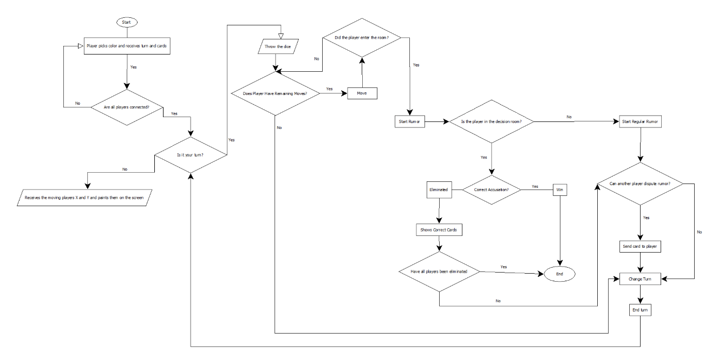
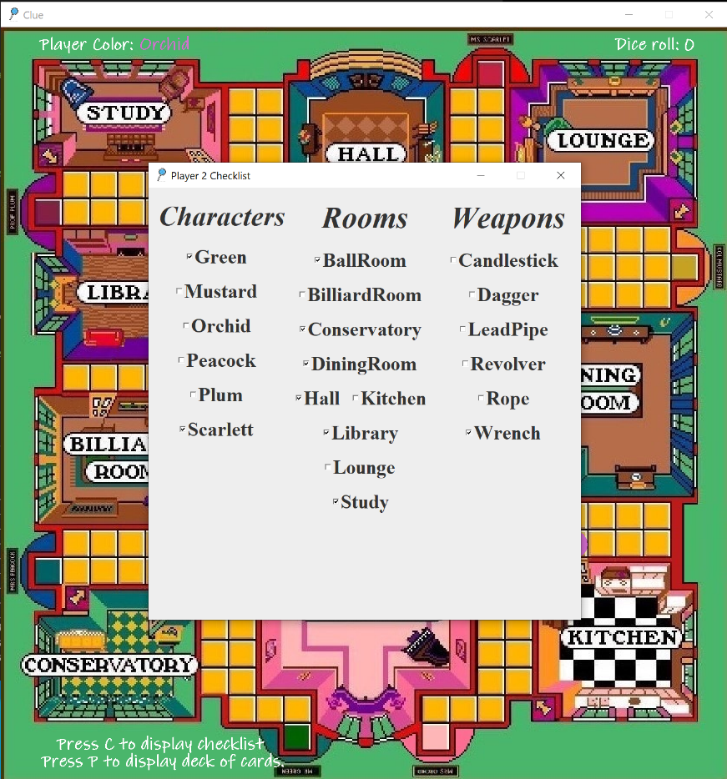
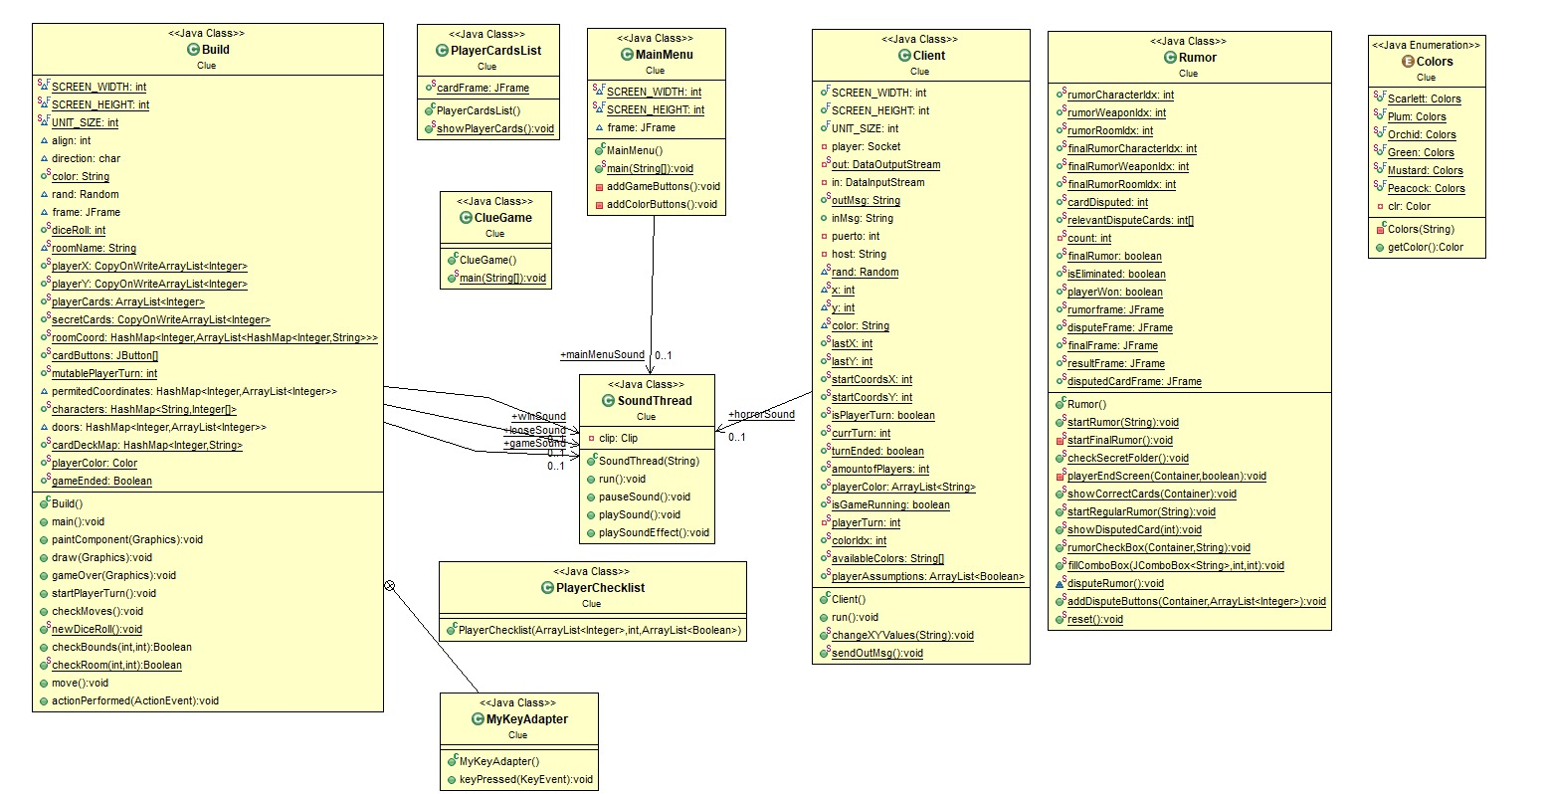
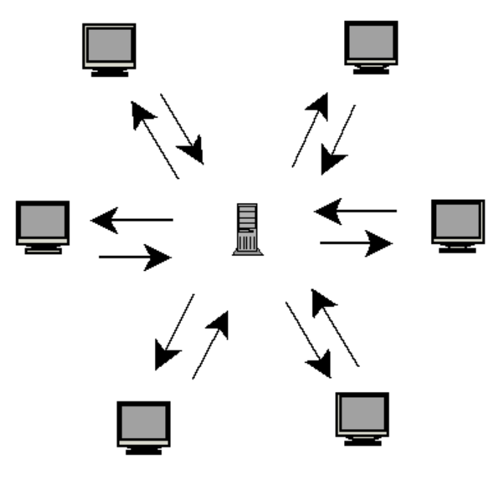
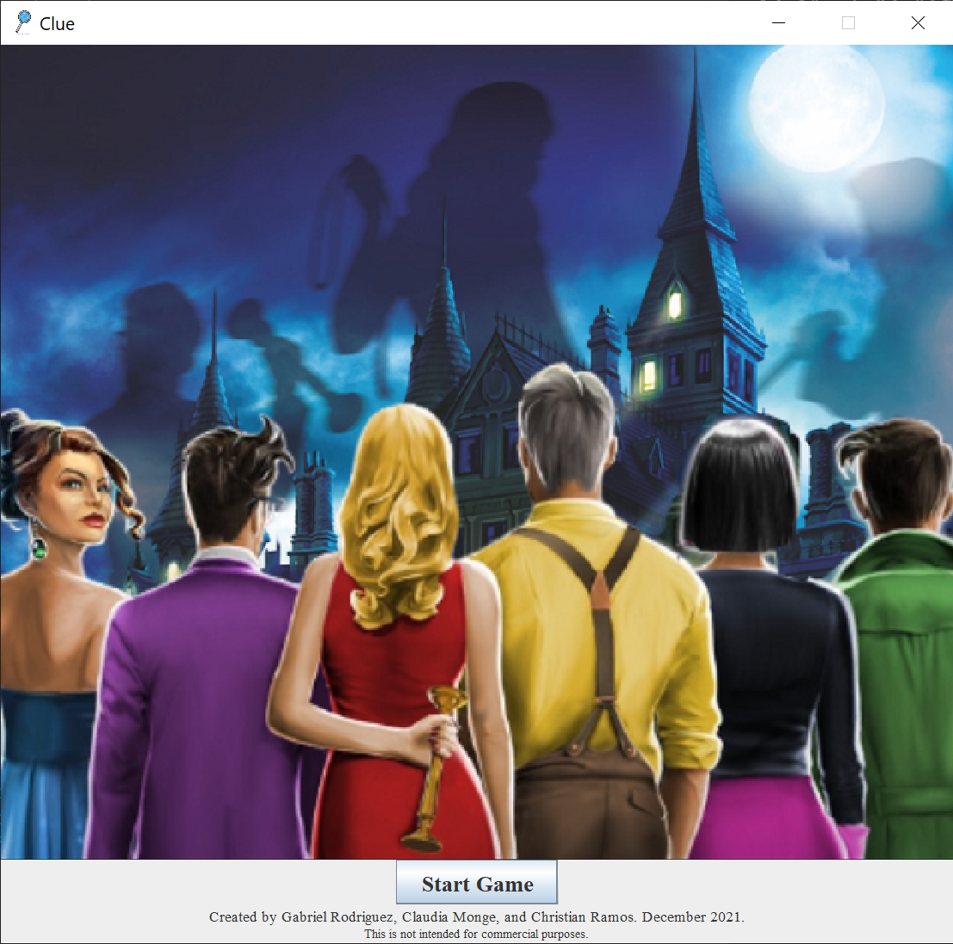
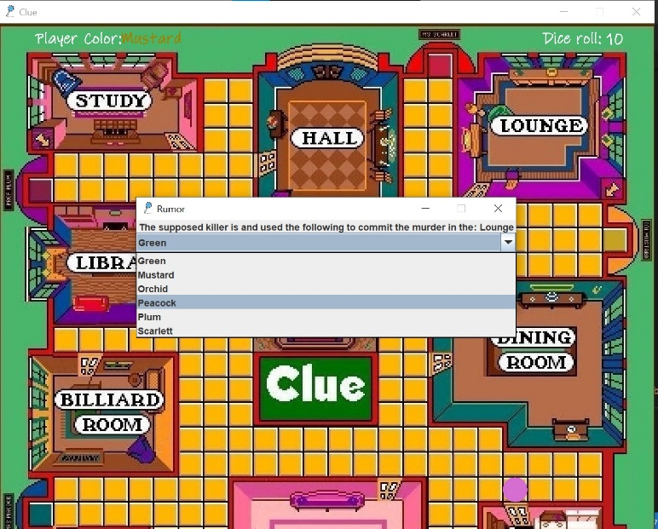
Clue: A Murder Mystery Board Game
Rodríguez García, Gabriel E. | Monge Torres, Claudia P. | Ramos Ortega, Christian J. gabriel.rodriguez87@upr.edu | claudia.monge@upr.edu | christian.ramos24@upr.edu Department of Computer Science, University of Puerto Rico at Bayamón
Professor: Dr. Juan M. Solá-Sloan
Introduction
Design
The cards available to dispute come from the deck of the player, which come from the Server that distributes the cards equitably to all the players. This distribution happens right after the Server stores the three cards in the secret folder, which are the murderer, the room, and the weapon.
A checklist was developed for the player to take notes by selecting the cards by their name. This helps the user narrow down the possible combinations of the three cards hidden in the secret folder. To make things easier for the player, a player card list was created with images of the actual cards that the deck of the player contains ( see figure4 ).
Figure 4
One cell, located at the center of the board, acts as a door to enter the final rumor room. In the final rumor room, the player must make a final assumption based on the notes taken from the gameplay. This final rumor decides if a player wins or looses. If the three cards chosen match the cards that contains the secret folder, the player wins. On the other side, if the cards do not match, the player is automatically eliminated, and the game goes on. The players that are eliminated can still dispute rumors but are limited to that.
For the user experience, we implemented a main menu ( see figure5 ). This main menu starts by letting the player start or join the game. If a player starts the game, the number of players to participate must be provided. After a player provides the number of players, that player and the rest of the players joining get to choose their character by selecting their distinct color with the click of a button.
Figure 5
Tools
Clue is a card game recreated from the traditional Hasbro Board Game. This was developed by Gabriel E. Rodríguez García, Claudia P. Monge Torres, and Christian J. Ramos Ortega. The Clue Game is a murder mystery game where the objective is to determine who murdered the game's victim, where the crime took place, and which weapon was used. Each player joins the game and assumes the role of one of the six suspects and attempts to deduce the correct answer by strategically moving around a game board representing the rooms of a mansion and collecting clues about the circumstances of the murder from the other players.
As part of the design process, we started developing a flowchart diagram of our projection for the game ( see Figure1 ).
Figure 1
Then to solidify the underlying design of our program, a UML with all the Java classes, and the members and fields needed was created ( see figure2 ).
Figure 2
Starting the coding process, the movement of the players was developed. This was accomplished by extracting a photo of the game board and dividing it in cells. The character pieces were created as the exact same size of one cell. This provides the user seamless movement through the board with the up, down, left, and right keys. The movement of the players is limited by a dice roll, which gives a random number between 1-12, determining the number of steps a player can take.
The movement of a player is then projected on the rest of the players board. This is accomplished using the Client-Server model. In our model, only one player is communicating with the Server at a time, sending the necessary information for the Server to send to the rest of the players as a broadcast. Both Client and Server were created as threads to maintain an active back-and-forth communication between them.
Each one of the cells on the board are an exact coordinate (x,y). A few of these cells are the exact position of a door to a room. When a player is in front of a door, a window with a drop-down selection ( see figure3 ) appears to allow them to make a rumor. If a rumor has been made, a random player on the board gets chosen to dispute the rumor that has been established, and another window appears with the photos of the cards available to dispute to the player disputing the rumor.
Figure 3
GitHub
Java
Visual Studio Code
Eclipse
Object Aid UML Explorer
DIA
Paint
GIMP
Digital Ocean
Objectives
Conclusion
Determine clues based on the opponent’s actions throughout the game.
Create accusations and dispute them.
Determine who murdered the game’s victim, where the crime took place, and which weapon was used.
The recreation of Clue provides entertainment to all ages, as well as a catalyst for mental health improvement. This game stimulates the players mind by using deduction to determine hints of the murder in the mansion, and ultimately win the game.
As the development of the game progressed, we faced many challenges which led us to learning new tools like GitHub. We used the platform for our project management, and to transfer and merge our work. Lastly, we used the Digital Ocean platform to create a droplet where the server resides. Every client connects to this host to exchange data and fulfill the communication process.
Communication Visualization
Future Work
As future work, this project envisions to optimize the number of windows, as well as increase the amount of interaction between the players. This would provide a more user-friendly game.
To extend the gameplay, the development of functional secret tunnels in the game board is also envisioned on the project, as well as developing full rounds of disputing a rumor for a more immersive gameplay.
Notes:
1

